Slide 1
Chapter 10
Transaction Management and Concurrency Control

Slide 2
Learning Objectives
In this chapter, students will learn:
  About database transactions and their properties
  What concurrency control is and what role it plays in maintaining the database’s integrity
  What locking methods are and how they work

Slide 3
Learning Objectives
In this chapter, students will learn:
  How stamping methods are used for concurrency control
  How optimistic methods are used for concurrency control
  How database recovery management is used to maintain database integrity

Slide 4
What is a Transaction?
Sell a product to a customer. Suppose that the customer may charge the purchase to his or her account. The sales transaction consists of at least the following parts:
  You must write a new customer invoice.
  You must reduce the quantity on hand in the product’s inventory.
  You must update the account transactions.
  You must update the customer balance.

Slide 5
What is a Transaction?
Any action that reads from and/or writes to a database may consist of:
  Simple SELECT statement to generate list of table contents
  Series of related UPDATE statements to change values of attributes in various tables
  Series of INSERT statements to add rows to one or more tables
  Combination of SELECT, UPDATE, and INSERT statements

Slide 6
What is a Transaction?
Database transactions reflect real-world transactions that are triggered by events such as buying a product, registering for a course, or making a deposit into a checking account.
Logical unit of work that must be entirely completed or aborted
Successful transaction changes database from one consistent state to another
  One in which all data integrity constraints are satisfied

Slide 7
What is a Transaction?
Most real-world database transactions are formed by two or more database requests
  Equivalent of a single SQL statement in an application program or transaction
When many transactions take place at the same time, they are called concurrent transactions
Managing the execution of such transactions is called concurrency control.

Slide 8
Database Transaction Processing
What is a database?
a collection of data items
·
·
usually models some real system
·
every data item has a name and value associated with it
·
Banking Database Example:
Account number = 12200507
Deposit = $1000
Withdrawals = $200
Balance = $ 800
·
every database is also associated with a set of integrity
constraints
·
example:
Balance > 0
Deposits - Withdrawals = Balance

Slide 9
Transactions
·
The fundamental purpose of a DBMS is to
carry out transactions
·
transactions
. sequence of read and write operations
. should either commit or abort
BEGIN
action
action
·
·
·
action
COMMIT

Slide 10
Evaluating Transaction Results
Not all transactions update database
  SQL code represents a transaction because it accesses a database
Suppose that on January 18, 2014, you register the credit sale of one unit of product 89-WRE-Q to customer 10016 for $277.55
  The required transaction affects the INVOICE, LINE, PRODUCT, CUSTOMER, and ACCT_TRANSACTION tables.

Slide 11
Evaluating Transaction Results
INSERT INTO invoice
VALUES(1009,10016,'2014-01-16 11:11:11',256.99,20.56,277.55,'cred',0.00,277.55);
UPDATE product
SET PROD_QOH=PROD_QOH-1
WHERE PROD_CODE='89-WRE-Q';
UPDATE customer
SET CUST_BALANCE=CUST_BALANCE+277.55
WHERE CUST_NUMBER=10016;
INSERT INTO acct_transaction
VALUES(10007,'2014-01-16 11:11:11',10016,'charge',277.55);

Slide 12
Evaluating Transaction Results
Improper or incomplete transactions can have devastating effect on database integrity
  Users can define enforceable constraints based on business rules
  Other integrity rules are automatically enforced by the DBMS

Slide 13
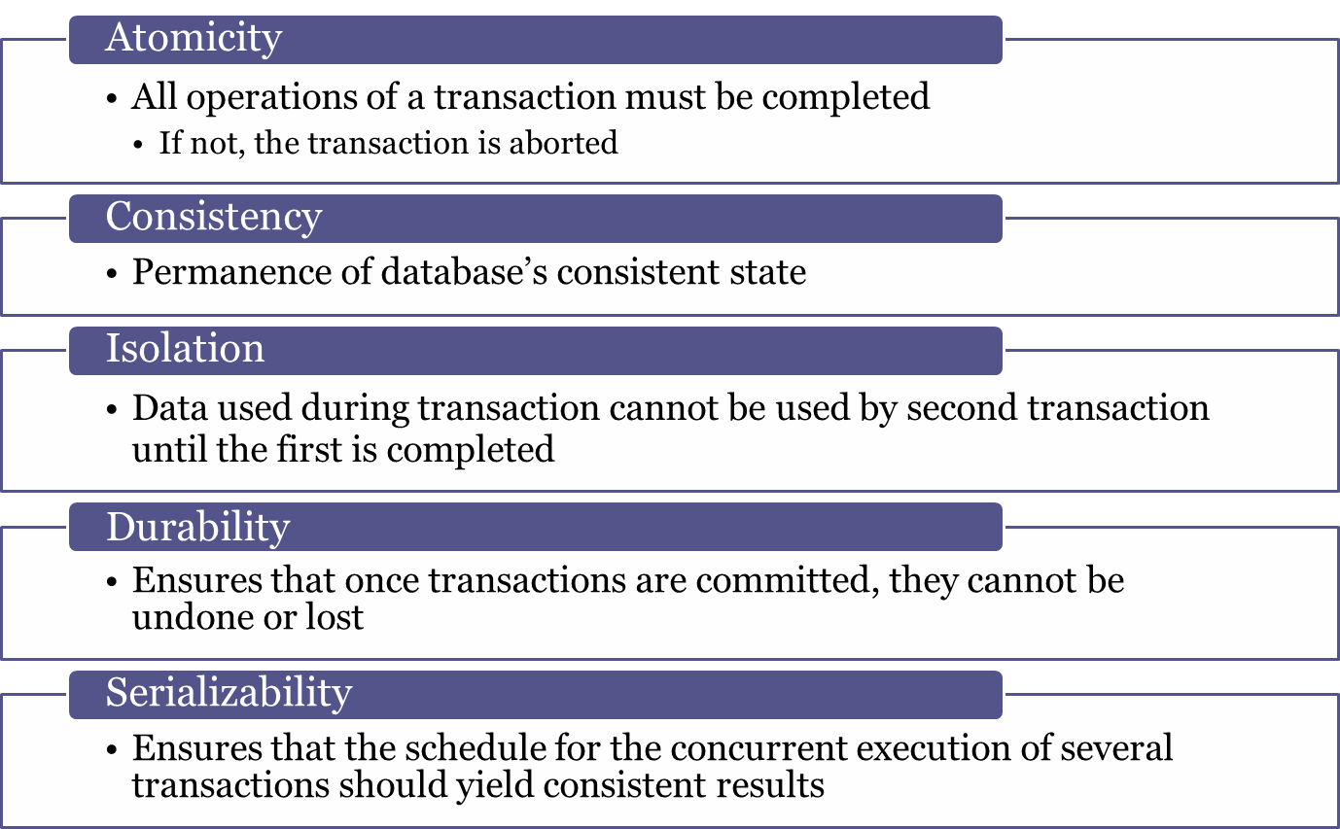
Transaction Properties

Slide 14
Transaction Management with SQL
ANSI has defined standards that govern SQL database transactions
Transaction support is provided by two SQL statements: COMMIT and ROLLBACK
Transaction sequence must continue until:
  COMMIT statement is reached
  ROLLBACK statement is reached
  End of program is reached
  Program is abnormally terminated

Slide 15
Concurrency Control
Coordination of the simultaneous transactions execution in a multiuser database system
Objective - Ensures serializability of transactions in a multiuser database environment
Note: Simultaneous execution of transactions over a shared database can create several data integrity and consistency problems

Slide 16
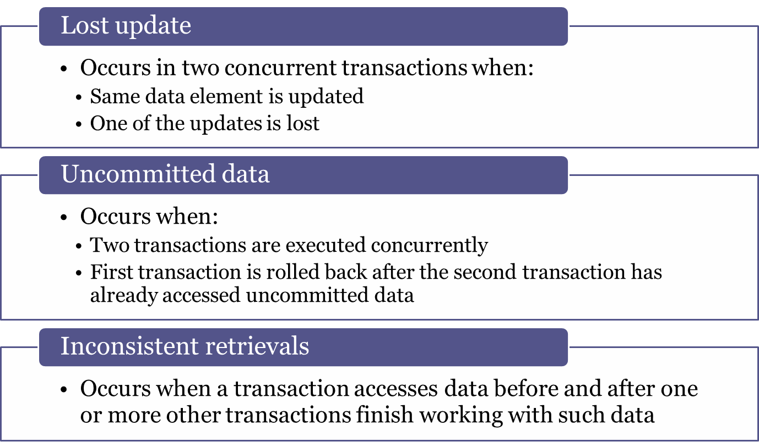
Problems in Concurrency Control

Slide 17
Concurrency Control
Concurrency: The Problem
Consider an example of banking database:
Assume Mr. Smith has two accounts
1. A checking account with balance = A
2. A savings account with balance = B
where the savings account is jointly owned by
Mr. Smith and Mrs. Smith

Slide 18
The Problem (continued)
Assume the current values of A and B are,
A = $ 1000
B = $ 10,000
Consider the following two transactions:
T1 initiated by Mr. Smith moves $ 100 from checking to savings
T2 initiated by Mrs. Smith deposits $ 10,000 into the savings
The new values of A and B should be,
A = $ 900
B = $ 20,100

Slide 19
Execution 1
Transaction T
Transaction T
1
2
Read A
A = A - $100
Read B
Write A
B = B + $ 10,000
Read B
Write B
Commit T
2
B = B + $100
Write B
Commit T
1
A and B are modified as,
A = $ 900
B = $ 10,100

Slide 20
Execution 2
Transaction T
Transaction T
1
2
Read A
A = A - $100
Write A
Read B
B = B + $100
Write B
Commit T
1
Read B
B = B + $ 10,000
Write B
Commit T
2
A and B are modified as,
A = $ 900
B = $ 20,100

Slide 21
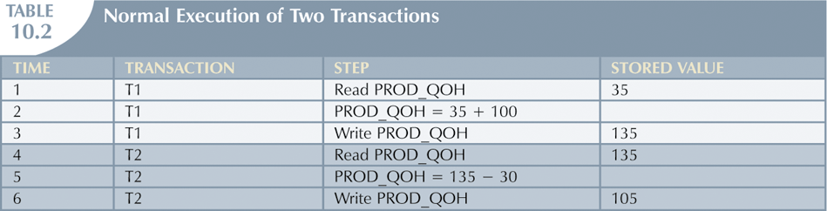
Lost Updates
Assume that you have a product whose current PROD_QOH value is 35. Also assume that two concurrent transactions, T1 (Purchase 100 units), T2 (Sell 30 units)

Slide 22
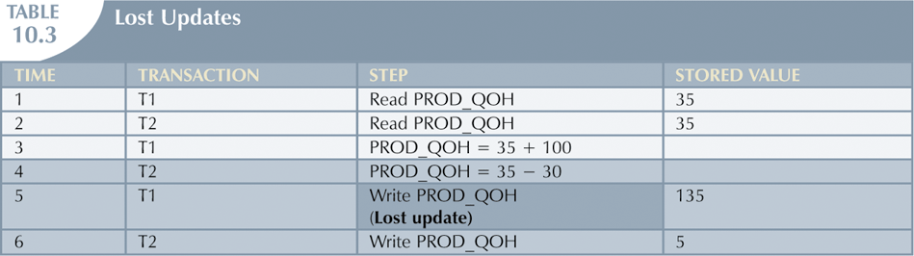
Lost Updates (continued)

Slide 23
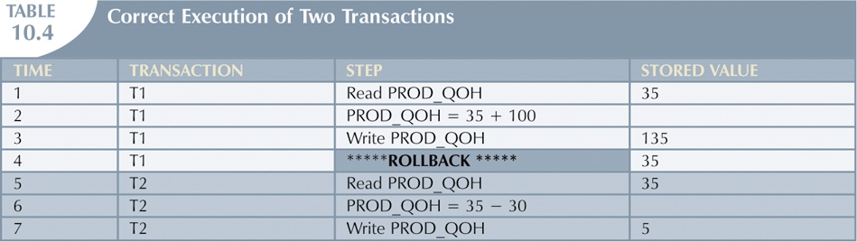
Uncommitted Data
Database Systems: Design, Implementation, & Management, 7th Edition, Rob & Coronel

Slide 24
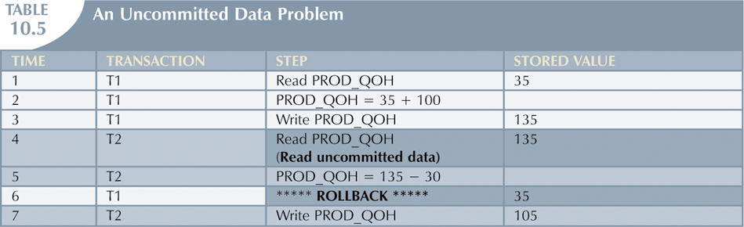
Uncommitted Data (continued)
Database Systems: Design, Implementation, & Management, 7th Edition, Rob & Coronel

Slide 25
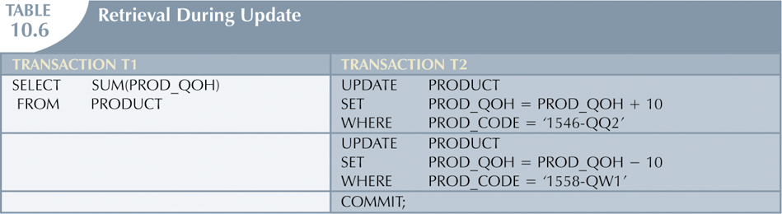
Inconsistent Retrievals
T1 calculates the total quantity on hand of the products stored in the PRODUCT table.
At the same time, T2 updates the quantity on hand for two of the PRODUCT table’s products.
Database Systems: Design, Implementation, & Management, 7th Edition, Rob & Coronel

Slide 26
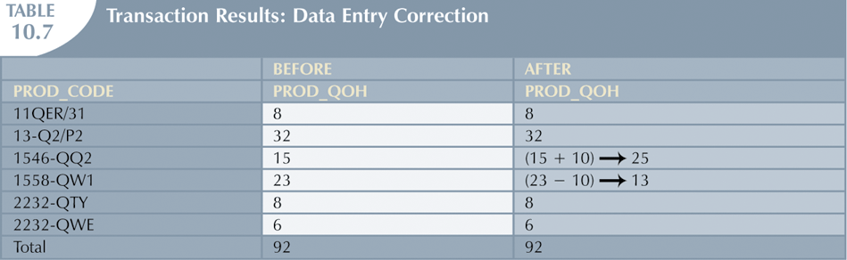
Inconsistent Retrievals (continued)
Database Systems: Design, Implementation, & Management, 7th Edition, Rob & Coronel

Slide 27
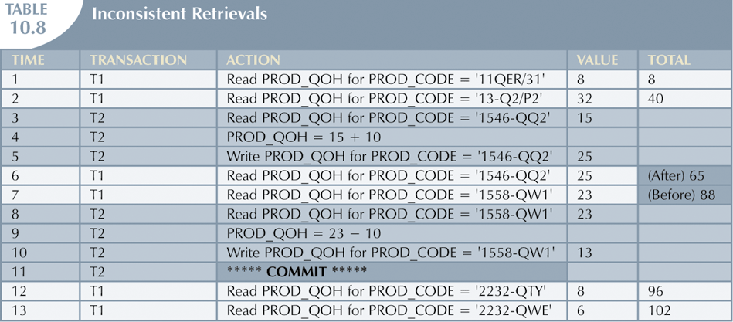
Inconsistent Retrievals (continued)

Slide 28
The Scheduler
Special DBMS program that establishes the order in which the operations are executed within concurrent transactions
  Interleaves the execution of database operations to ensure serializability and isolation of transactions
Bases its actions on concurrency control algorithms
(locking or time stamping) to determine the
appropriate order

Slide 29
The Scheduler (continued)
Creates serialization schedule
  Serializable schedule: Interleaved execution of transactions yields the same results as the serial execution of the transactions
Thus, it facilitates data isolation to ensure that two transactions do not update same data element at same time

Slide 30
Execution 1
Transaction T
Transaction T
1
2
Read A
A = A - $100
Read B
Write A
B = B + $ 10,000
Read B
Write B
Commit T
2
B = B + $100
Write B
Commit T
1
A and B are modified as,
A = $ 900
B = $ 10,100

Slide 31
Execution 2
Transaction T
Transaction T
1
2
Read A
A = A - $100
Write A
Read B
B = B + $100
Write B
Commit T
1
Read B
B = B + $ 10,000
Write B
Commit T
2
A and B are modified as,
A = $ 900
B = $ 20,100

Slide 32
Execution 3
Transaction T
Transaction T
1
2
Read A
Read B
A = A - $100
B = B + $ 10,000
Write A
Write B
Commit T
2
Read B
B = B + $100
Write B
Commit T
1
A and B are modified as,
A = $ 900
B = $ 20,100

Slide 33
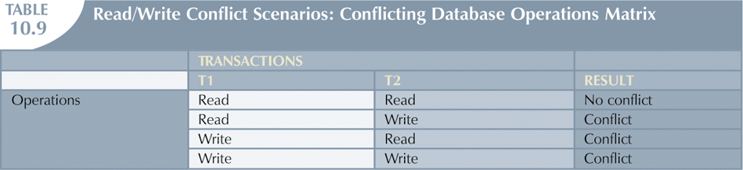
The Scheduler (continued)

Slide 34
Concurrency Control with Locking Methods
Lock
  Guarantees exclusive use of a data item to a current transaction
  Required to prevent another transaction from reading inconsistent data
Pessimistic locking: Use of locks based on the assumption that conflict between transactions is likely
Lock manager: Responsible for assigning and policing the locks used by the transactions

Slide 35
Lock Granularity
Indicates the level of lock use
Levels of locking
  Database-level lock
  Table-level lock
  Page-level lock
    Page or diskpage: Directly addressable section of a disk
  Row-level lock
  Field-level lock

Slide 36
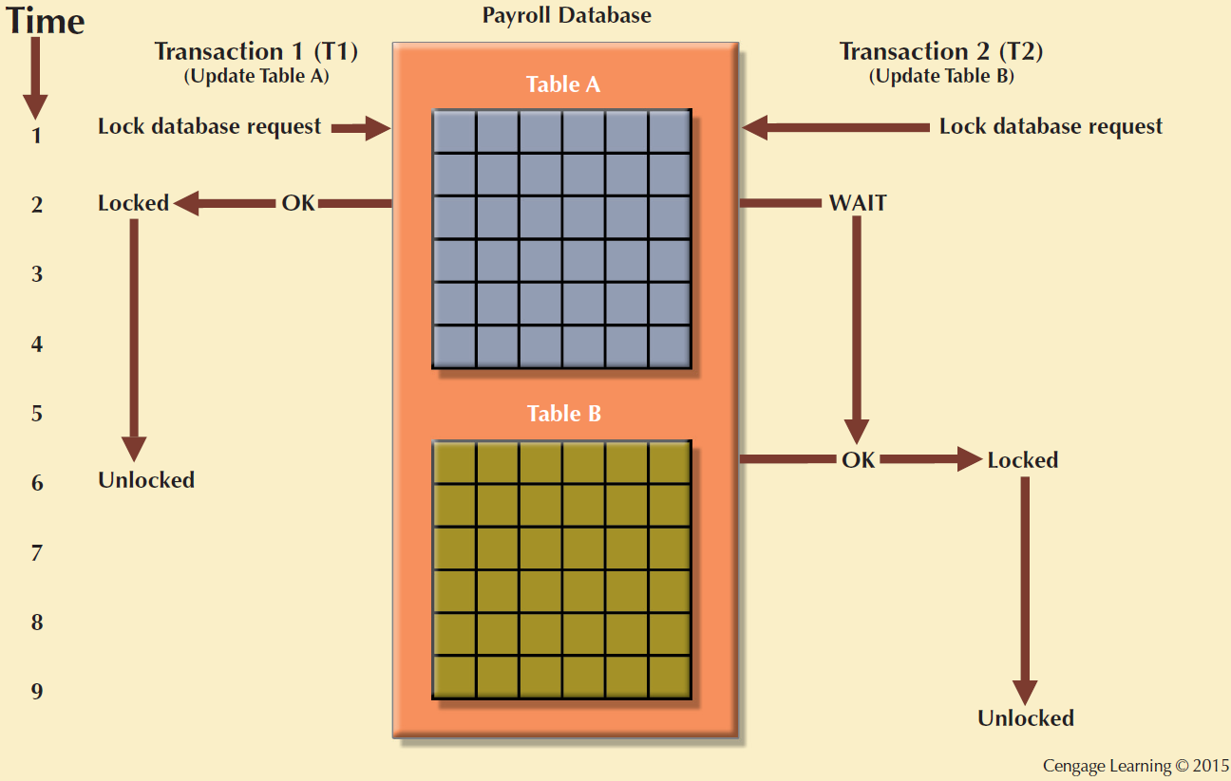
Figure 10.3 - Database-Level Locking Sequence

Slide 37
Database-Level Locking Sequence
The entire database is locked, thus preventing the use of any tables in the database by transaction T2 while transaction T1 is being executed.
It is unsuitable for multiuser DBMSs. You can imagine how slow data access would be if thousands of transactions had to wait for the previous transaction to be completed before the next one could reserve the entire database.

Slide 38
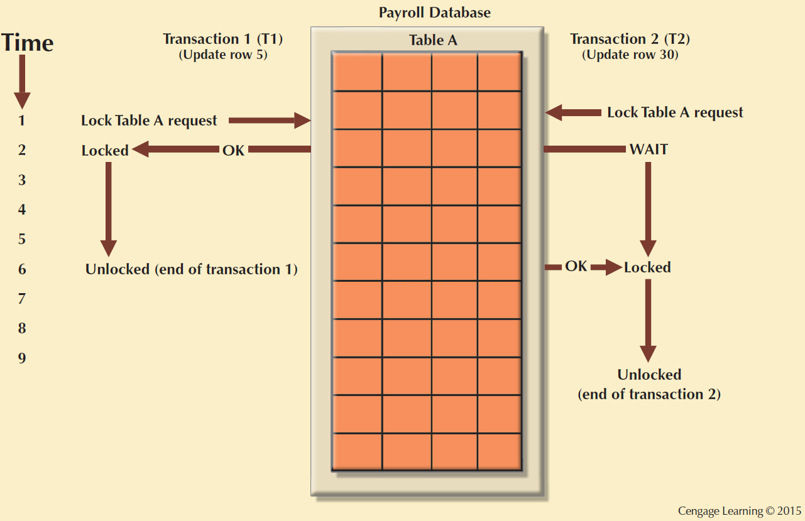
Figure 10.4 - An Example of a Table-Level Lock

Slide 39
Table-Level Lock
In a table-level lock, the entire table is locked, preventing access to any row by transaction T2 while transaction T1 is using the table.
If a transaction requires access to several tables, each table may be locked.
Two transactions can access the same database as long as they access different tables.
Cause traffic jams when many transactions are waiting to access the same table.

Slide 40
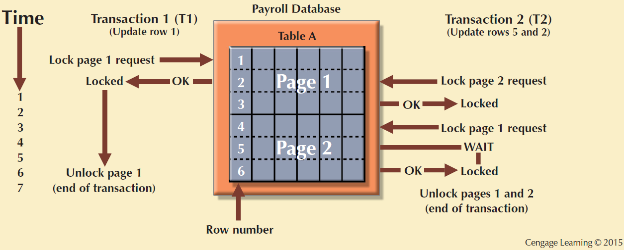
Figure 10.5 - An Example of a Page-Level Lock

Slide 41
Page-Level Lock
In a page-level lock, the DBMS locks an entire disk page.
A disk page, or page, is the equivalent of disk block, which can be described as a directly addressable section of a disk.
A page has a fixed size, such as 4K, 8K or 16K.
If you want to write only 73 bytes to a 4K page, the entire 4K page must be read from disk, updated in memory, and written back to disk.
A table can span several pages, and a page can contain several rows of one or more table.

Slide 42
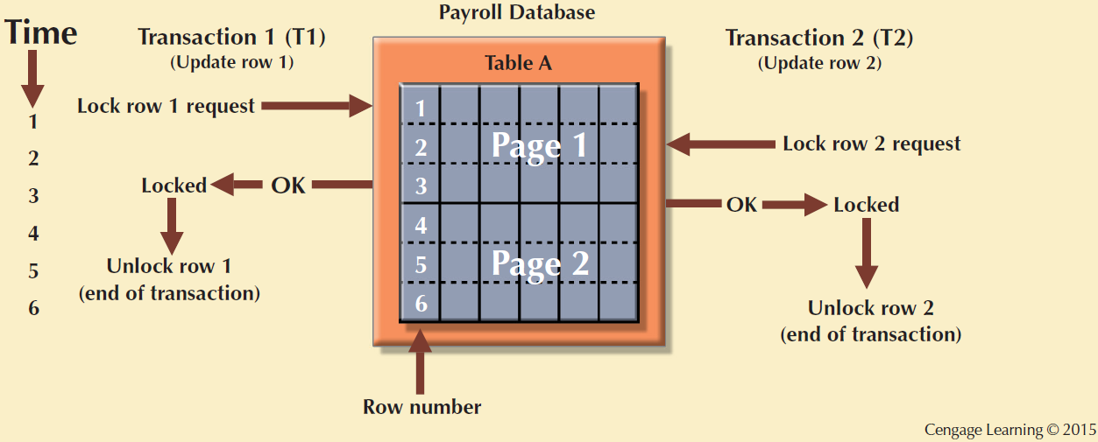
Figure 10.6 - An Example of a Row-Level Lock

Slide 43
Row-Level Lock
The DBMS allows concurrent transactions to access different rows of the same table even when the rows are located on the same page.
A lock exists for each row involved in a conflicting transaction.

Slide 44
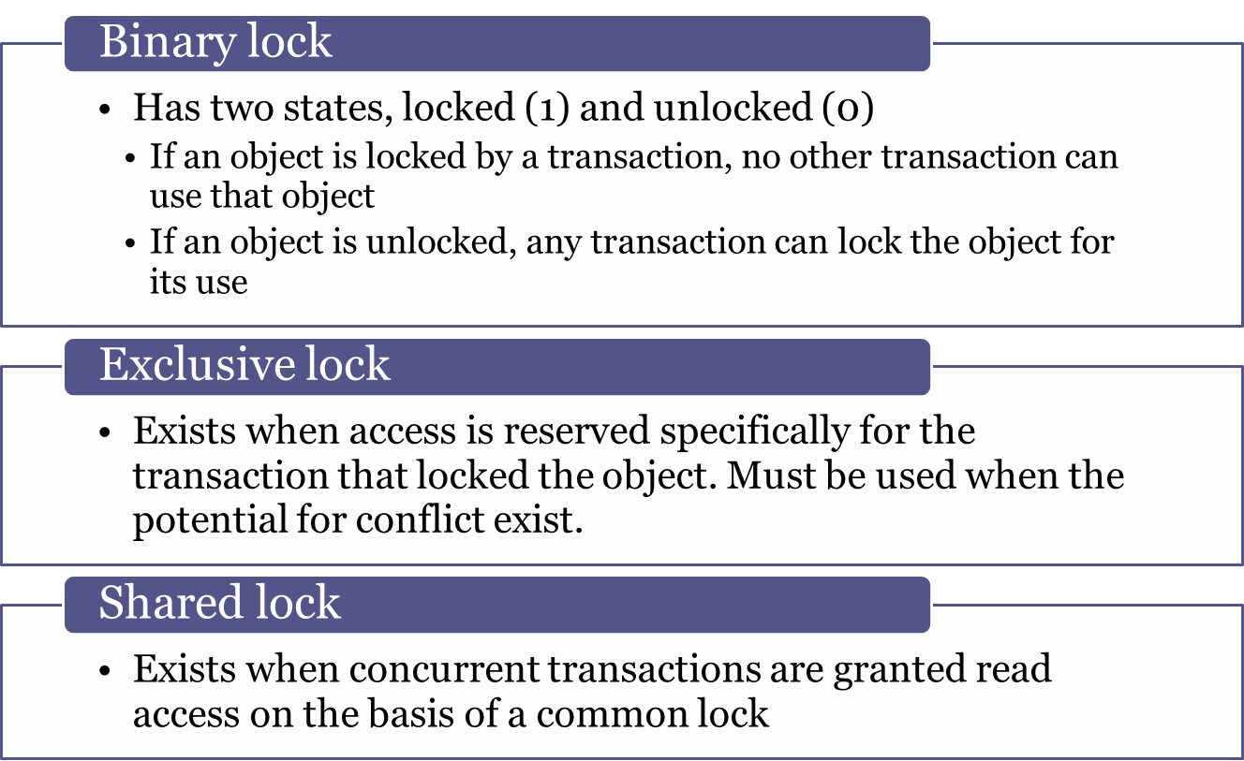
Lock Types

Slide 45
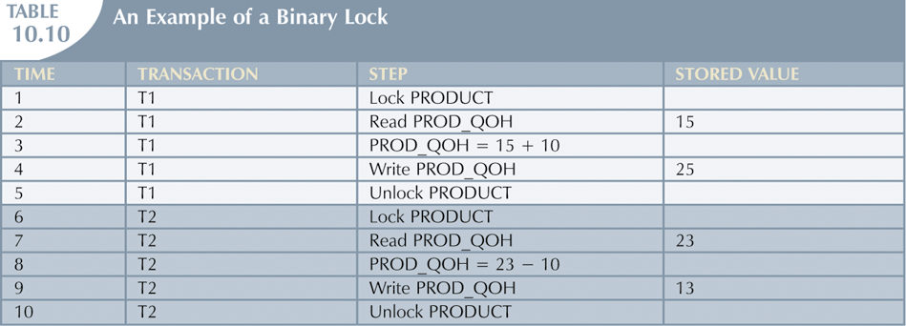
Lock Types (continued)
DBMS will not allow two transactions to read the same database object even though neither transaction updates the database and therefore no concurrency problems can occur.

Slide 46
Problems in Using Locks
Resulting transaction schedule might not be serializable
Schedule might create deadlocks
  A deadlock occurs when two transactions wait indefinitely for each other to unlock data.

Slide 47
Two-Phase Locking (2PL)
Defines how transactions acquire and relinquish locks
Guarantees serializability but does not prevent deadlocks
Phases
  Growing phase - Transaction acquires all required locks without unlocking any data
  Shrinking phase - Transaction releases all locks and cannot obtain any new lock

Slide 48
Two-Phase Locking (2PL)
Governing rules
  Two transactions cannot have conflicting locks
  No unlock operation can precede a lock operation in the same transaction
  No data are affected until all locks are obtained – that is, until transaction is in its locked point

Slide 49
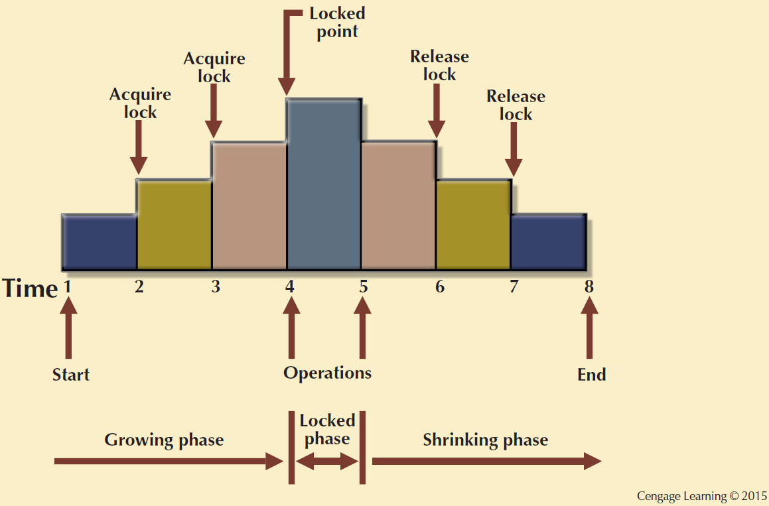
Figure 10.7 - Two-Phase Locking Protocol

Slide 50
Deadlocks
Occurs when two transactions wait indefinitely for each other to unlock data
  Known as deadly embrace
Possible only if one of the transactions wants to obtain an exclusive lock on a data item
  No deadlock condition can exist among shared locks

Slide 51
Deadlocks
T1= access data items X and Y
T2= access data items Y and X
If T1 has not unlocked data item Y, T2 can not begin
If T2 has not unlocked data item X, T1 cannot continue.

Slide 52
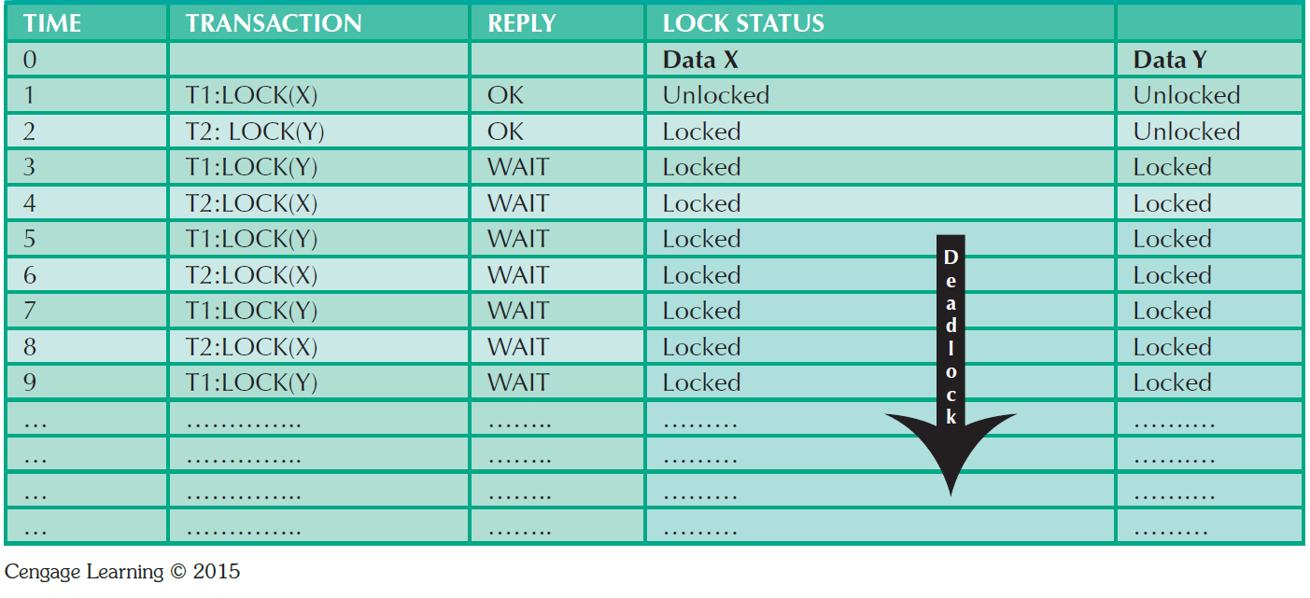
Table 10.13 - How a Deadlock Condition is Created

Slide 53
Deadlocks (continued)
Control techniques
  Deadlock prevention
  Deadlock detection
  Deadlock avoidance
Choice of deadlock control method depends on database environment

Slide 54
Time Stamping
Assigns global, unique time stamp to each transaction
  Produces explicit order in which transactions are submitted to DBMS
Properties
  Uniqueness: Ensures no equal time stamp values exist
  Monotonicity: Ensures time stamp values always increases

Slide 55
Time Stamping
Disadvantages
  Each value stored in the database requires two additional stamp fields (one for last time the field was read and one for the last update)
  Increases memory needs
  Increases the database’s processing overhead
  Demands a lot of system resources because many transactions might have to be stopped, rescheduled, and restamped.

Slide 56
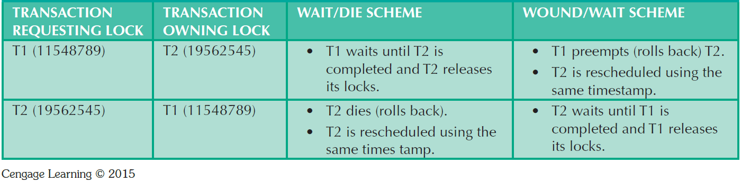
Table 10.14 - Wait/Die and Wound/Wait Concurrency Control Schemes
Two schemes used to decide which transaction is rolled back and which continues executing: wait/die scheme and the would/wait scheme.

Slide 57
Table 10.14 - Wait/Die and Wound/Wait Concurrency Control Schemes
Wait/die scheme: The older transaction waits for the younger one to complete and release its locks.
  If the transaction requesting the lock is the older of the two transactions, it will wait until the other transaction is completed and the locks are released.
  If the transaction requesting the lock is the younger of the two transactions, it will die (roll back) and is rescheduled using the same time stamp.

Slide 58
Table 10.14 - Wait/Die and Wound/Wait Concurrency Control Schemes
Wound/wait scheme: the older transaction rolls back the younger transaction then reschedules it.
  If the transaction requesting the lock is the older of the two transactions, it will preempt (wound) the younger transaction by rolling it back.
  If the transaction requesting the lock is the younger of he two transactions, it will wait until the other transaction is completed and the locks are released.

Slide 59
Concurrency Control with Optimistic Methods
Optimistic approach: Based on the assumption that the majority of database operations do not conflict
  Does not require locking or time stamping techniques
  Transaction is executed without restrictions until it is committed
  Each transaction moves through two or three phases, referred to as read, validation, and write.

Slide 60
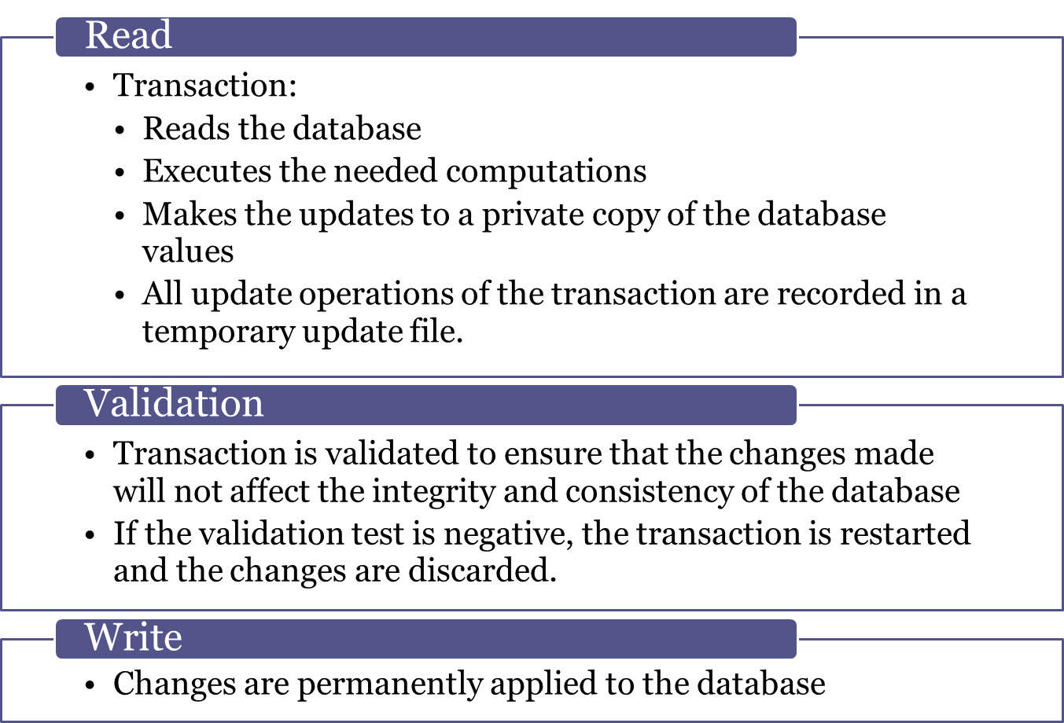
Phases of Optimistic Approach

Slide 61
Transaction Isolation Levels
To further understand how transaction management is implemented in a database, we should understand the transaction isolation levels as defined in ANSI SQL 1992 standard.
  Dirty read: a transaction can read data that is not yet committed.
  Nonrepeatable read: a transaction reads a given row at time t1, and then it read the same row at time t2, yielding different results. The original row may have been updated or deleted.
  Phantom read: a transaction executes a query at time t1, and then it runs the same query at time t2, yielding additional rows that satisfy the query.

Slide 62
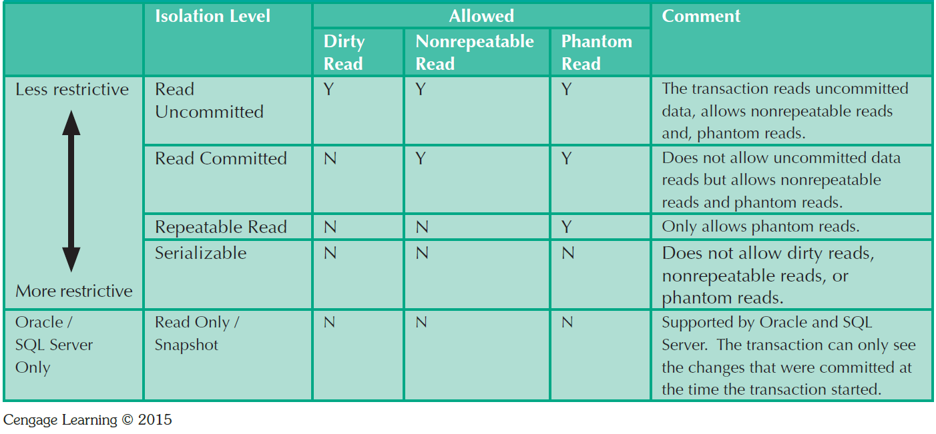
Table 10.15 - Transaction Isolation Levels

Slide 63
Transaction Isolation Levels
Read uncommitted: read uncommitted data from other transactions. The data base does not place any locks on the data, which increases transaction performance but at the cost of data consistency.
Read Committed: forces transactions to read only committed data. The database will use exclusive locks on data, causing other transactions to wait until the original transaction commits.
Repeatable Read: ensures that queries return consistent results. This type of isolation level uses shared locks to ensure other transactions do not update a row after the original query reads it.
Serializable isolation: most restrictive level defined by the ANSI SQL standard.

Slide 64
Database Recovery Management
Database recovery: Restores database from a given state to a previously consistent state
Recovery transactions are based on the atomic transaction property
  Atomic transaction property: All portions of a transaction must be treated as a single logical unit of work
    If transaction operation cannot be completed:
      Transaction must be aborted
      Changes to database must be rolled back

Slide 65
Recovery Management
  Example: Mr. Smith moves $100 from checking to savings
  Each transaction must be atomic
  That is either all changes made by a transaction are permanently installed in the database (if it commits) or no changes persist (if it aborts)
Read A
Read B
A = A - $100
B = B + $100
Write A
What if System Failure occurs
at this point?
Write B

Slide 66
Transaction Log
Keeps track of all transactions that update the database
Transaction log stores:
  A record for the beginning of transaction
  For each transaction component (SQL statement):
    Type of operation being performed (update, delete, insert)
    Names of objects affected by transaction
    “Before” and “after” values for updated fields
    Pointers to previous and next transaction log entries for the same transaction
  Ending (COMMIT) of the transaction

Slide 67
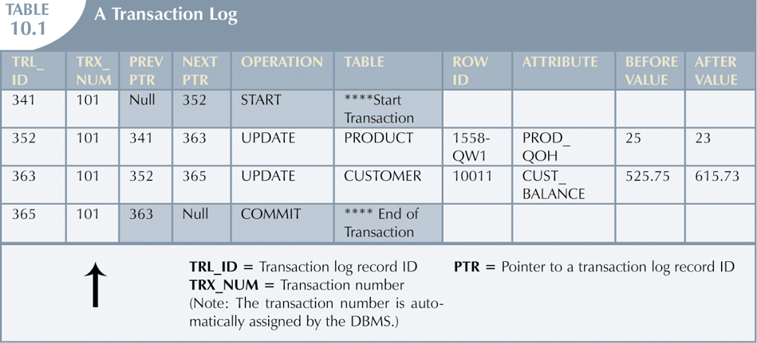
The Transaction Log (continued)

Slide 68
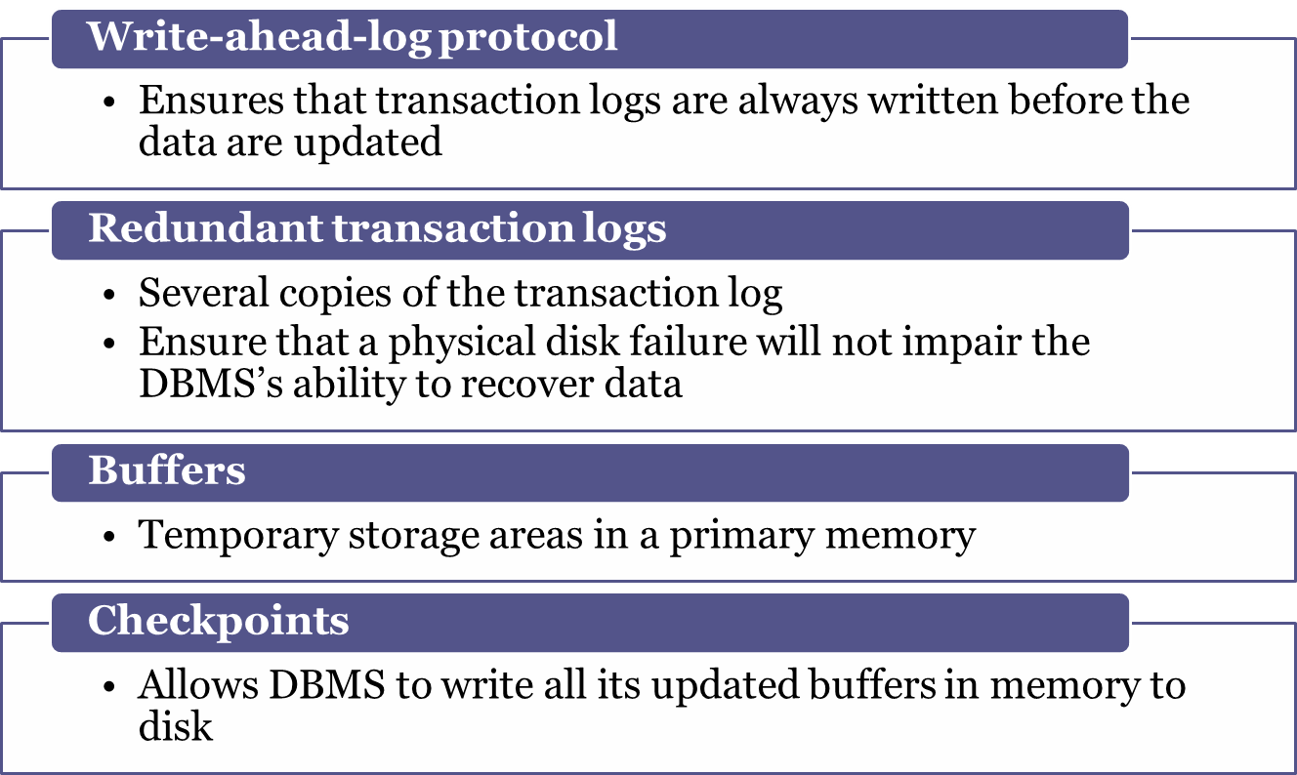
Concepts that Affect Transaction Recovery

Slide 69
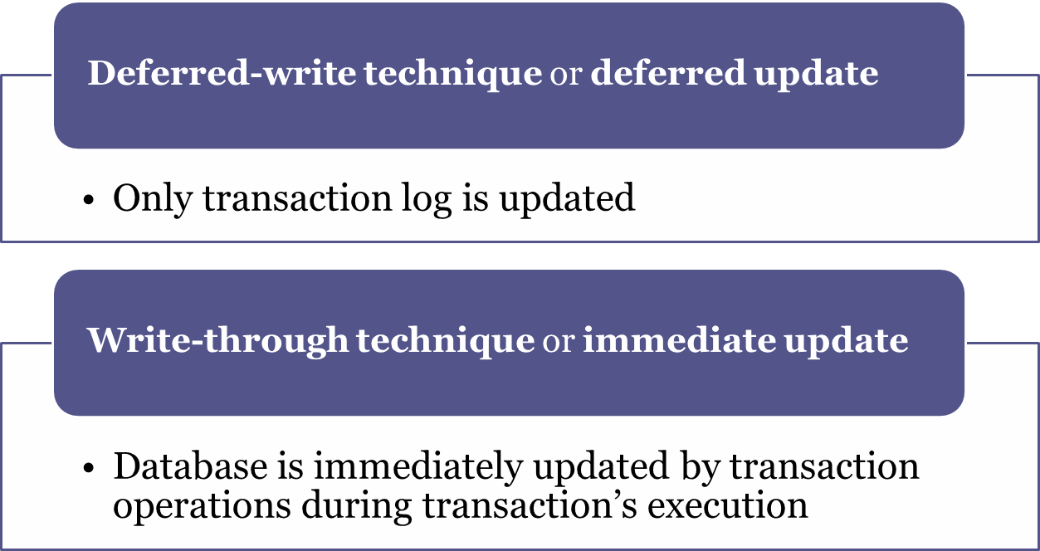
Techniques used in Transaction Recovery Procedures

Slide 70
Recovery Process in Deferred-Write Technique
Identify the last check point in the transaction log
If transaction was committed before the last check point
  Nothing needs to be done
If transaction was committed after the last check point
  Transaction log is used to redo the transaction
If transaction had a ROLLBACK operation after the last check point
  Nothing needs to be done

Slide 71
Recovery Process in Write-Through Technique
Identify the last checkpoint in the transaction log
If transaction was committed before the last check point
  Nothing needs to be done
If transaction was committed after the last checkpoint
  Transaction must be redone
If transaction had a ROLLBACK operation after the last check point
  Transaction log is used to ROLLBACK the operations

Slide 72
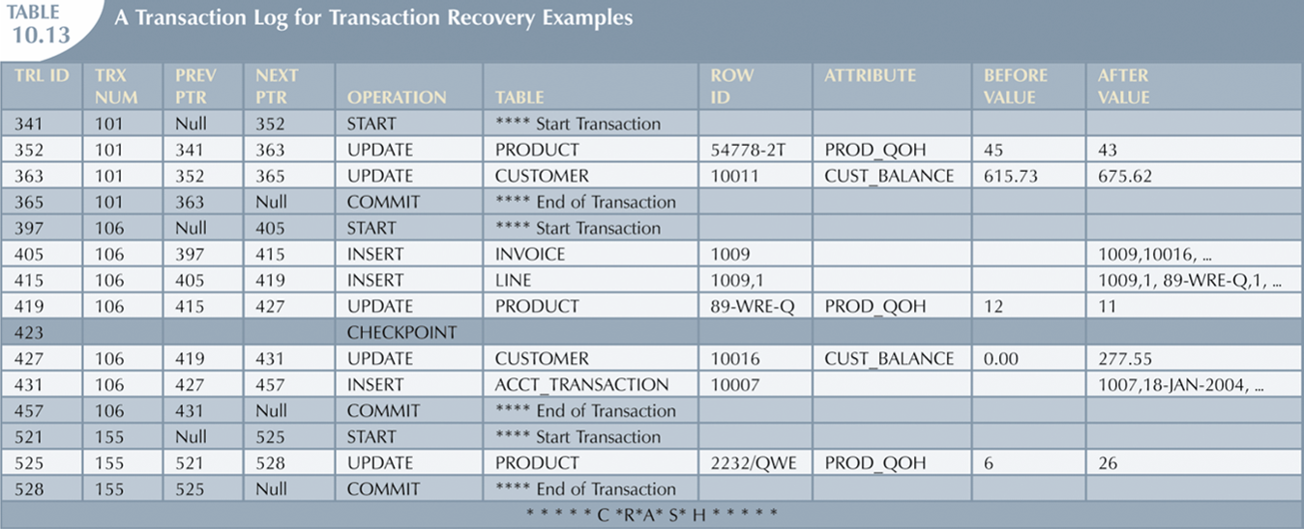
Transaction Recovery (continued)
Start T1
(T1, x, old value, new value)
Start T2
(T2, y, old value, new value)
commit T1
The checkpoint event writes only the changes for all previously committed transactions.
The checkpoint applies all changes made by transaction 101 to the database data files

Slide 73
Transaction Recovery (continued)
Deferred update method:
  Identify the last checkpoint-in this case, TRL ID 423. This was the last time database buffers were physically written to disk.
  Note that transaction 101 started and finished before the last checkpoint. All changes were already written to disk, and no additional action need to be taken.

Slide 74
Transaction Recovery (continued)
Deferred update method:
  For each transaction committed after the last checkpoint (TRL ID 423), the DBMS will use the transaction log data to write the changes to disk, using the “after” values.
  For example, for transaction 106:
    Find COMMIT (TRL ID 457).
    Use the previous pointer values to locate the start of the transaction (TRL ID 397).
    Use the next pointer values to locate each DML statement, and apply the changes to disk using the “after” values. (Start with TRL ID 405, then 415,419,427, and 431.) Remember that TRL ID 457 was the COMMIT statement for this transaction.
    Repeat the process for transaction 155.

Slide 75
Transaction Recovery (continued)
Deferred update method:
  Any other transaction will be ignored.
  For transaction that ended with ROLLBACK, nothing is done because no changes were written to disk.

Slide 76
Summary
Transaction
  Sequence of database operations that access database
  Represents real-world events
  Must be logical unit of work
    No portion of transaction can exist by itself
  Takes database from one consistent state to another
    One in which all data integrity constraints are satisfied

Slide 77
Summary (continued)
Transactions have five main properties: atomicity, consistency, isolation, durability, and serializability
SQL provides support for transactions through the use of two statements: COMMIT and ROLLBACK
SQL transactions are formed by several SQL statements or database requests

Slide 78
Summary (continued)
Transaction log keeps track of all transactions that modify database
Concurrency control coordinates simultaneous execution of transactions
Scheduler is responsible for establishing order in which concurrent transaction operations are executed

Slide 79
Summary (continued)
Lock guarantees unique access to a data item by transaction
Two types of locks can be used in database systems: binary locks and shared/exclusive locks
Serializability of schedules is guaranteed through the use of two-phase locking

Slide 80
Summary (continued)
When two or more transactions wait indefinitely for each other to release lock, they are in deadlock, or deadly embrace
Three deadlock control techniques: prevention, detection, and avoidance
Database recovery restores database from given state to previous consistent state

